Slide 1
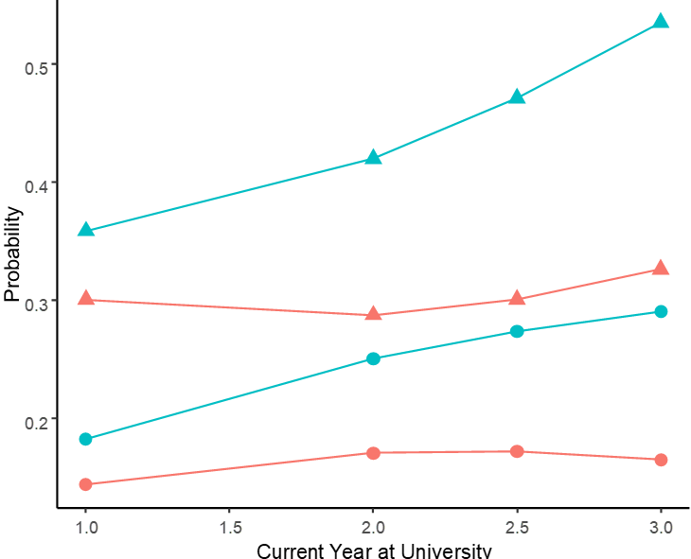
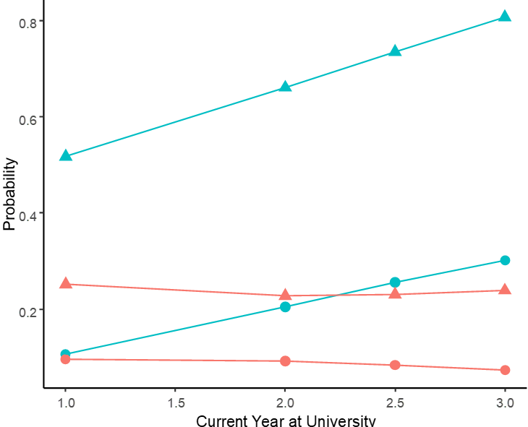
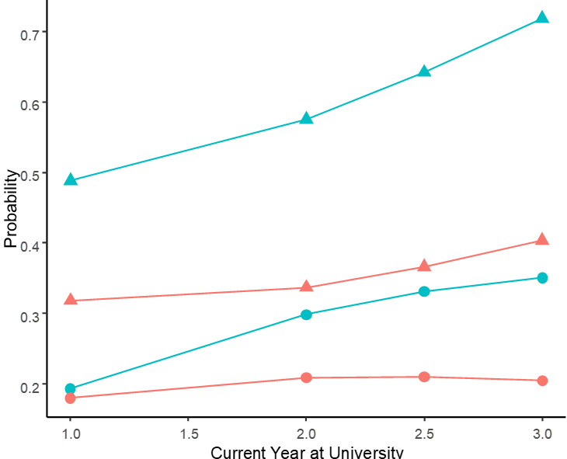
*
Significant interaction
Wave 1
Crisis Awareness
Learned About Open Science
Can Explain Open Science
Perceived Applicability of Issues
*
*
0.6
0.5
0.8
0.95
0.8
0.4
Probability
0.4
0.9
0.6
0.3
0.2
0.85
0.4
0.2
0.8
Y1
Y2
PY
Y3
Y1
Y2
PY
Y3
Y1
Y2
PY
Y3
Y1
Y2
PY
Y3
Wave 2
*
0.8
1.0
0.7
0.8
0.6
0.9
Probability
0.5
0.6
0.4
0.8
0.4
0.2
0.3
0.7
Y1
Y2
PY
Y3
Y1
Y2
PY
Y3
Y1
Y2
PY
Y3
Y1
Y2
PY
Y3

Slide 2
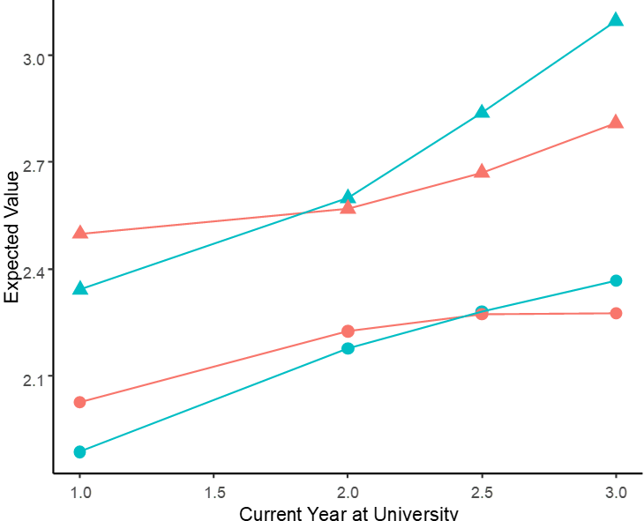
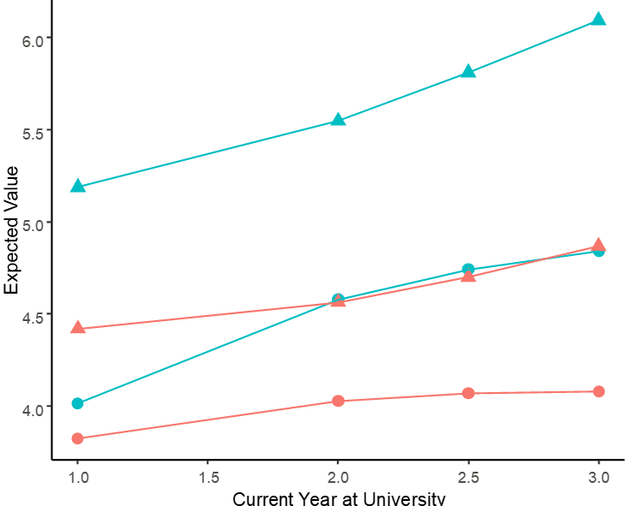
*
Significant interaction
Wave 1
Conceptual Perception
Situational Perception
Awareness
Experience
0.8
0.8
*
5.5
*
3.0
0.7
0.6
5.0
2.7
Expected Value
4.5
2.4
0.6
0.4
4.0
2.1
0.5
0.2
Y1
Y2
PY
Y3
Y1
Y2
PY
Y3
Y1
Y2
PY
Y3
Y1
Y2
PY
Y3
Wave 2
0.9
*
0.8
*
*
6.0
3.0
0.7
0.6
2.5
Expected Value
5.0
0.4
2.0
0.5
0.2
4.0
1.5
Y1
Y2
PY
Y3
Y1
Y2
PY
Y3
Y1
Y2
PY
Y3
Y1
Y2
PY
Y3

